Slide 1
Unit: 2 (Machine learning clustering algorithms-II)

Slide 2
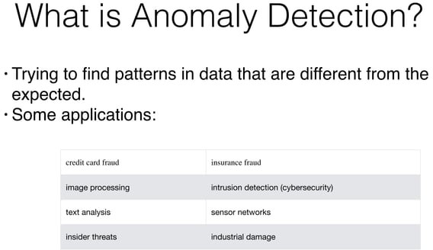
Anomaly detection in machine learning refers to the process of identifying data points or patterns that deviate significantly from the norm or the expected behavior.

Slide 3


Slide 4
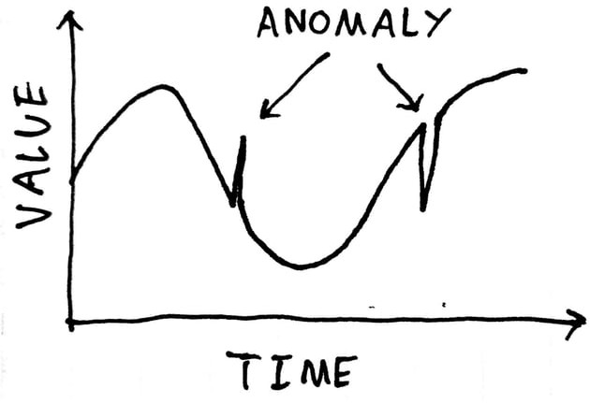

Slide 5
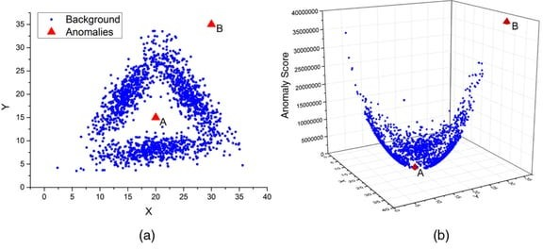

Slide 6
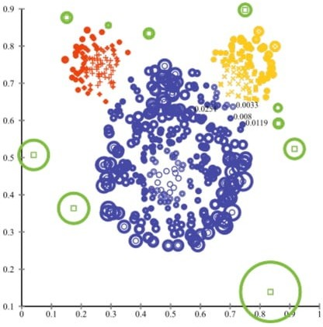

Slide 7
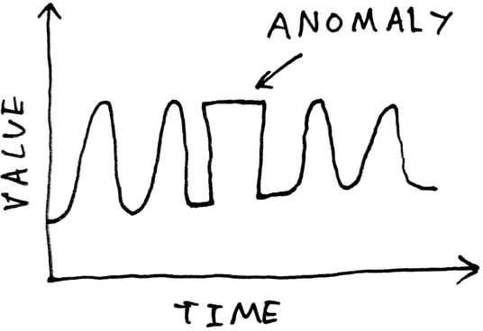

Slide 8
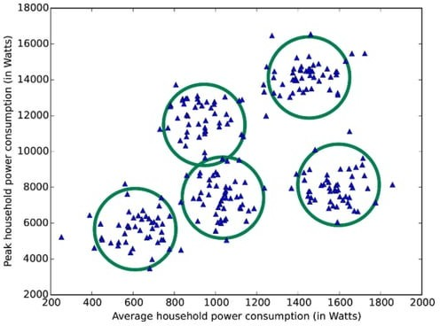

Slide 9
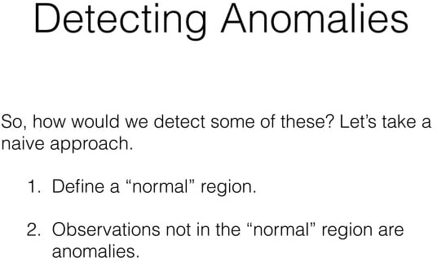

Slide 10
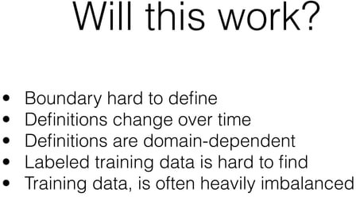

Slide 11
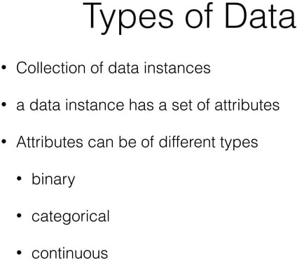

Slide 12
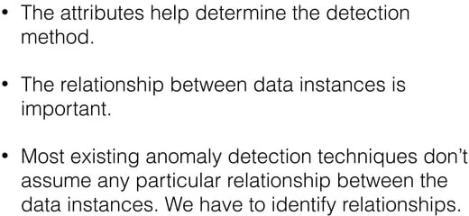

Slide 13
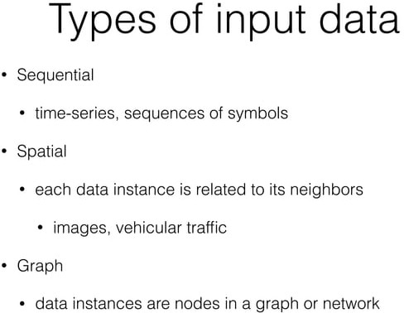

Slide 14
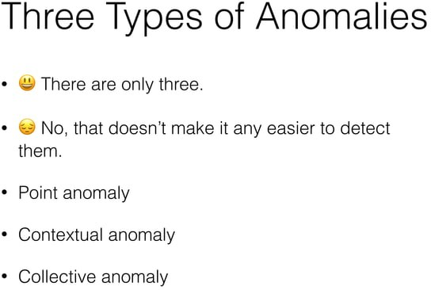

Slide 15
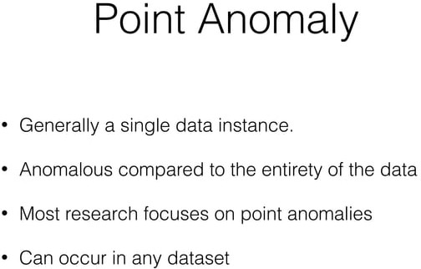
Point anomalies, also known as global anomalies, refer to individual data points that deviate significantly from the rest of the data. These anomalies are isolated and stand out from the majority of the data points.
Example: Detecting a fraudulent credit card transaction where the transaction amount is far larger or smaller than the typical spending behavior of the cardholder.

Slide 16
Contextual Anomalies
Contextual anomalies, also called conditional anomalies, are data points that are considered anomalous only within a specific context or condition. These anomalies might be normal in one context but abnormal in another.
Example: An increase in web traffic on a retail website during holiday seasons might not be anomalous, but the same traffic increase on a different website not related to retail during the same time could be considered anomalous.

Slide 17
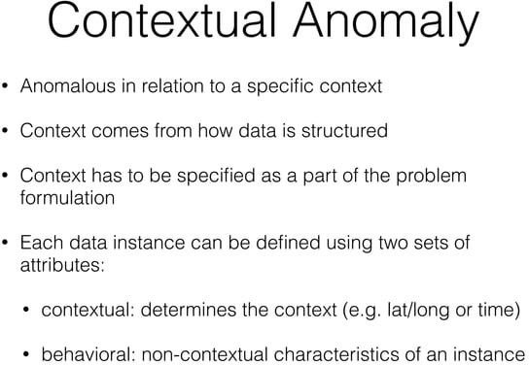

Slide 18
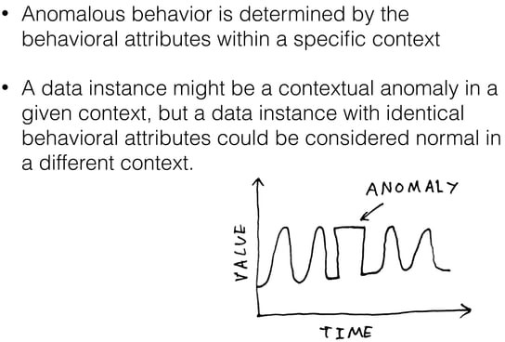

Slide 19
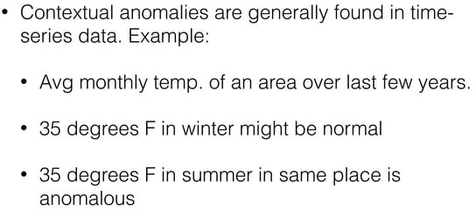

Slide 20
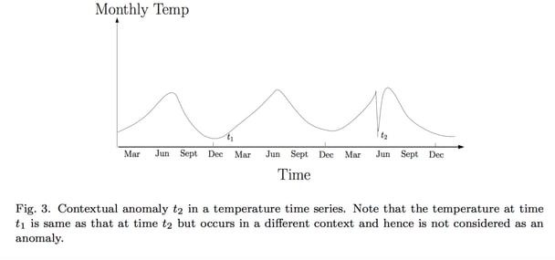

Slide 21
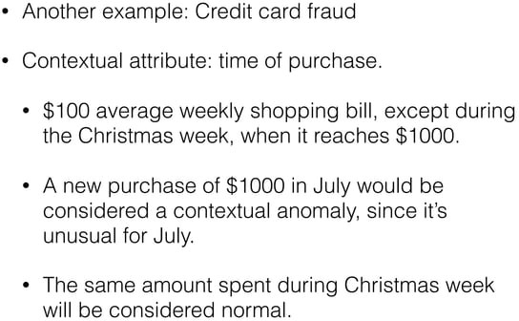

Slide 22
Collective Anomalies
Collective anomalies, also known as group anomalies or cluster-level anomalies, involve a group or a subset of data instances that collectively exhibit anomalous behavior when considered together. Individually, the data points might appear normal, but their combination is abnormal.
Example: Identifying a cluster of network devices that exhibit unusual communication patterns compared to the overall network traffic. While each device's behavior might appear normal on its own, the collective behavior of the devices as a group is anomalous.

Slide 23
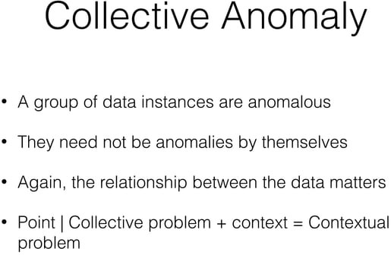

Slide 24
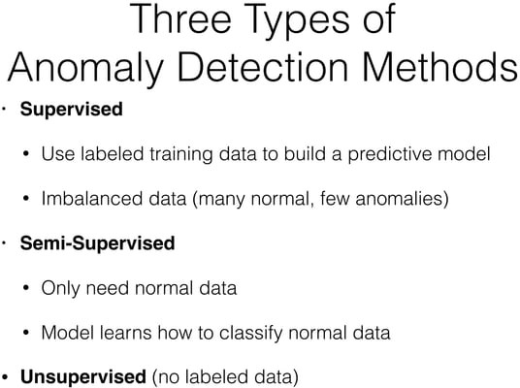

Slide 25


Slide 26


Slide 27
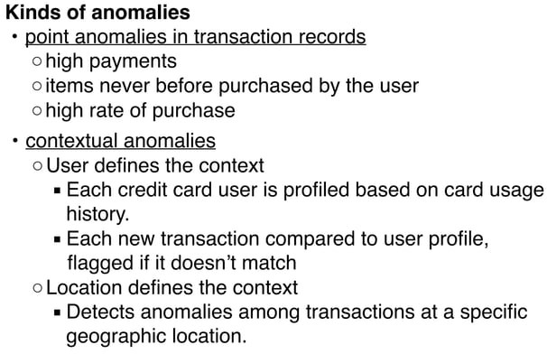

Slide 28
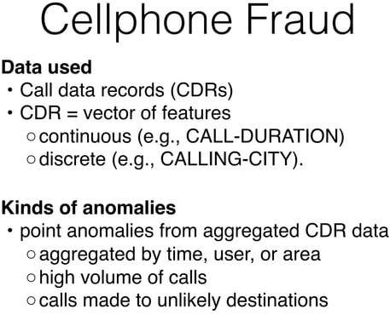

Slide 29
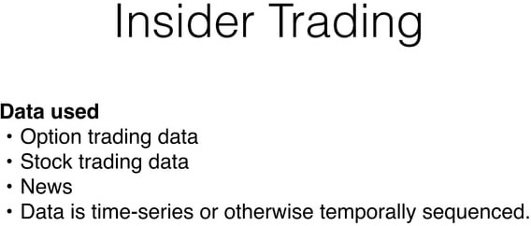

Slide 30


Slide 31
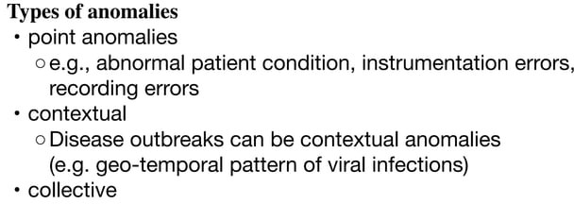

Slide 32
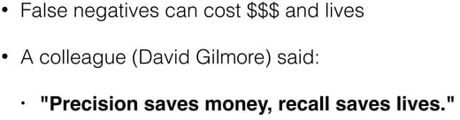

Slide 33
Gaussian Distribution
In this approach, all the features are modeled on a Gaussian Distribution and given a new data-point, the probability of the data-point is given by Gaussian/Normal Distribution Function.
If the probability is below a particular threshold (which is set depending upon the performance of the model on the Validation Set), the new data-point is claimed to be an outlier or anomalous.

Slide 34
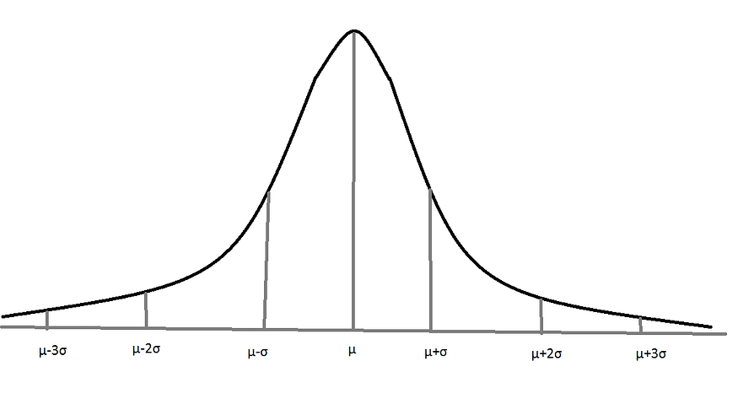
Gaussian/Normal Distribution with Mean = µ and Standard Deviation = σ

Slide 35
Gaussian Distribution Anomaly Detection Algorithm:
Let us consider that there are m data-points (instances) each with n selected features.
The Mean parameter for each feature (j = 1 to n) is fit.
The Variance parameter for each feature (j = 1 to n) is fit.
Given a new data-point, x = {x_1, x_2, … , x_j}, p(x) is given by,
or,
Now, a threshold parameter, ε is selected such that,
if p(x) < ε: # x is an ANOMALY or OUTLIER !!!! else: # x is NOT an ANOMALY or OUTLIER !!!!

Slide 36
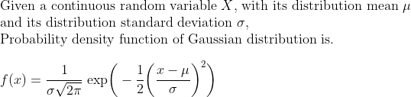
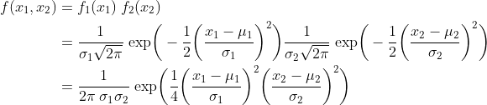
The probability density function, defined as f(x), measures the probability of some outcome x
For a two uncorrelated feature case, this becomes

Slide 37
Anomaly Detection using Decision Tree
import numpy as np
import matplotlib.pyplot as plt
from sklearn.tree import DecisionTreeClassifier
from sklearn.model_selection import train_test_split
from sklearn.metrics import confusion_matrix
# Generate synthetic data
np.random.seed(42)
normal_data = np.random.randn(1000, 2) * 2 # Normal data points
anomaly_data = np.random.randn(50, 2) * 10 # Anomaly data points
# Create labels (0 for normal, 1 for anomalies)
labels = np.zeros(normal_data.shape[0])
anomaly_labels = np.ones(anomaly_data.shape[0])
labels = np.concatenate((labels, anomaly_labels))
# Combine normal and anomaly data
data = np.vstack((normal_data, anomaly_data))

Slide 38
# Split data into training and testing sets
X_train, X_test, y_train, y_test = train_test_split(data, labels, test_size=0.2, random_state=42)
# Fit Decision Tree model
model = DecisionTreeClassifier(random_state=42)
model.fit(X_train, y_train)
# Predict anomalies
predictions = model.predict(X_test)
# Evaluate model performance
conf_matrix = confusion_matrix(y_test, predictions)
print("Confusion Matrix:")
print(conf_matrix)
# Plot the data and decision boundary
plt.scatter(X_test[:, 0], X_test[:, 1], c=predictions, cmap=plt.cm.Paired)
plt.title("Anomaly Detection using Decision Tree")
plt.xlabel("Feature 1")
plt.ylabel("Feature 2")
plt.show()

Slide 39
Program for Anomaly Detection using KMeans
# Fit K-Means model
num_clusters = 5
model = KMeans(n_clusters=num_clusters)
model.fit(data)
# Assign data points to clusters
cluster_labels = model.labels_
# Calculate cluster sizes
cluster_sizes = np.bincount(cluster_labels)
import numpy as np
import matplotlib.pyplot as plt
from sklearn.cluster import KMeans
# Generate synthetic data
np.random.seed(42)
normal_data = np.random.randn(1000, 2) * 2 # Normal data points
anomaly_data = np.random.randn(50, 2) * 10 # Anomaly data points
# Combine normal and anomaly data
data = np.vstack((normal_data, anomaly_data))

Slide 40
# Define a threshold for cluster size to identify potential anomalies
anomaly_threshold = np.percentile(cluster_sizes, 5) # 5th percentile cluster size
# Identify potential anomalies
potential_anomalies = data[cluster_labels[np.where(cluster_sizes <= anomaly_threshold)]]
# Plot the data and potential anomalies
plt.scatter(data[:, 0], data[:, 1], c='blue', label='Normal Data')
plt.scatter(potential_anomalies[:, 0], potential_anomalies[:, 1], c='red', label='Potential Anomalies')
plt.legend()
plt.title("Anomaly Detection using K-Means")
plt.xlabel("Feature 1")
plt.ylabel("Feature 2")
plt.show()

Slide 41
Isolation Forest
Isolation Forest is a machine learning algorithm specifically designed for anomaly detection.
It works by isolating anomalies in a dataset using random forests.
This algorithm is efficient and effective, particularly for high-dimensional data or data with complex patterns.

Slide 42
Algorithm
Isolation Concept:
The fundamental idea behind Isolation Forest is that anomalies are easier to isolate than normal data points. In other words, anomalies require fewer partitions to be separated from the rest of the data.
Random Partitioning:
Isolation Forest randomly selects a feature and a random split value within the range of that feature for each decision tree it builds.
Tree Construction:
The algorithm constructs a forest of isolation trees. Each tree is grown recursively by partitioning the data into subsets using the random splits mentioned earlier.
Scoring Anomalies:
Anomalies have shorter average path lengths within the trees compared to normal data points. The path length is the number of edges traversed to isolate a data point. Anomalies are isolated faster, leading to shorter path lengths.

Slide 43
Anomaly Score:
The anomaly score for a data point is the average path length across all the trees in the forest. This score reflects how easily the point can be separated from the rest.
Detection Threshold:
Anomalies tend to have lower anomaly scores compared to normal data points. By setting a threshold on the anomaly score, you can classify data points as anomalies if their scores are below the threshold.

Slide 44
Anomaly Detection using Isolation Forest
# Combine normal and anomaly data
data = np.vstack((normal_data, anomaly_data))
# Fit Isolation Forest model
model = IsolationForest(contamination=0.05) # Contamination parameter sets expected proportion of anomalies
model.fit(data)
import numpy as np
import matplotlib.pyplot as plt
from sklearn.ensemble import IsolationForest
# Generate synthetic data
np.random.seed(42)
normal_data = np.random.randn(1000, 2) * 2 # Normal data points
anomaly_data = np.random.randn(50, 2) * 10 # Anomaly data points

Slide 45
# Predict anomalies
predictions = model.predict(data)
# Plot the data and detected anomalies
plt.scatter(data[:, 0], data[:, 1], c=predictions, cmap=plt.cm.Paired)
plt.title("Anomaly Detection using Isolation Forest")
plt.xlabel("Feature 1")
plt.ylabel("Feature 2")
plt.show()

Slide 46
Write a program to detect anomalies in iris dataset using Isolation Forest.

Slide 47
Thank you!

